Slide 1


William Stallings Computer Organization and Architecture 8th Edition
Chapter 9
Computer Arithmetic
Book by : Computer, Architecture and Organizations, 8th Edition ,William Stalling
Original Slides by : Adrian J Pullin

Slide 2
Computer Arithmetic

Slide 3
Lecture Outcomes
Understanding of:
Arithmetic & Logic Unit
Integer Representation
Adder sub tractor Circuit

Slide 4
Arithmetic & Logic Unit
Does the calculations
Everything else in the computer is there to service this unit
Handles integers
May handle floating point (real) numbers
May be separate FPU (maths co-processor)
May be on chip separate FPU (486DX +)

Slide 5
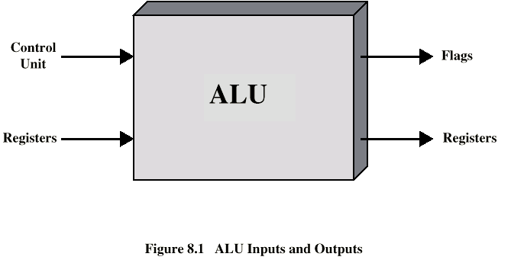
ALU Inputs and Outputs

Slide 6
What is signed number?
In computing, signed number representations are required to encode negative numbers in binary number systems

Slide 7
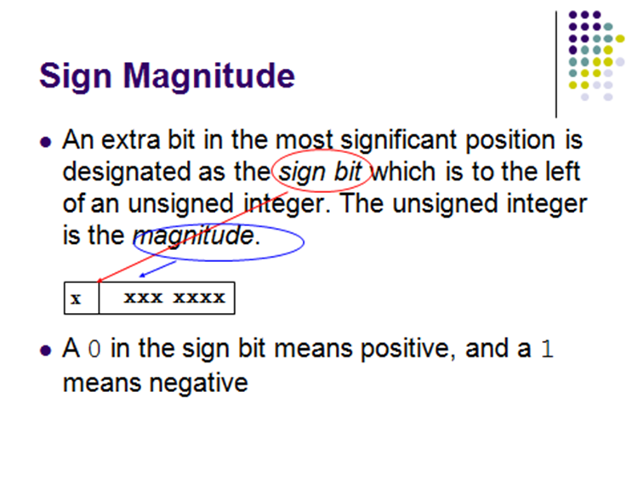
Sign Magnitude

Slide 8
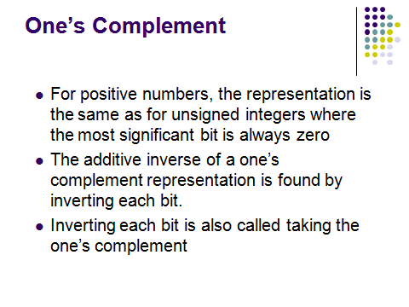
1’s Complement

Slide 9
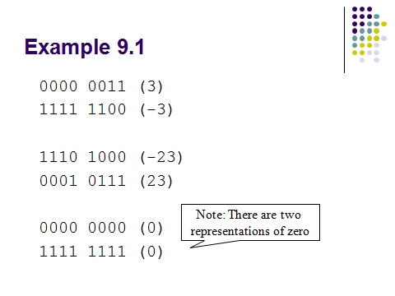
Example

Slide 10
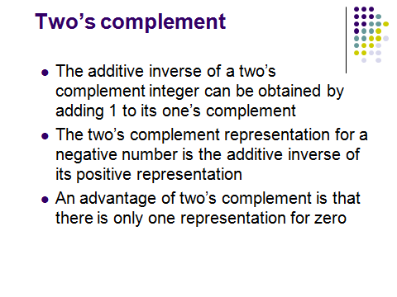
Two’s Complement

Slide 11
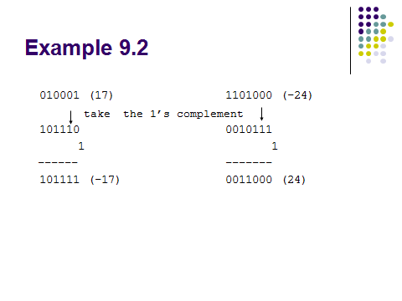
Example

Slide 12
Comparing the signed number systems
Here are all the 4-bit numbers in the different systems.
Positive numbers are the same in all three representations.
Signed magnitude and one’s complement have two ways of representing 0. This makes things more complicated.

Slide 13
Converting signed numbers to decimal
Convert 110101 to decimal, assuming this is a number in:
(a) signed magnitude format
(b) ones’ complement
(c) two’s complement

Slide 14
Signed overflow
With two’s complement and a 4-bit adder, for example, the largest represent able decimal number is +7, and the smallest is -8.
What if you try to compute 4 + 5, or (-4) + (-5)?
0 1 0 0 (+4)
+ 0 1 0 1 (+5)
0 1 0 0 1 (-7)
1 1 0 0 (-4)
+ 1 0 1 1 (-5)
1 0 1 1 1 (+7)

Slide 15
We cannot just include the carry out to produce a five-digit result, as for unsigned addition. If we did, (-4) + (-5) would result in +23!
Also, unlike the case with unsigned numbers, the carry out cannot be used to detect overflow.
In the example on the left, the carry out is 0 but there is overflow.
Conversely, there are situations where the carry out is 1 but there is no overflow.

Slide 16
Detecting signed overflow
The easiest way to detect signed overflow is to look at all the sign bits.
0 1 0 0 (+4)
+ 0 1 0 1 (+5)
0 1 0 0 1 (-7)
1 1 0 0 (-4)
+ 1 0 1 1 (-5)
1 0 1 1 1 (+7)

Slide 17
Overflow occurs only in the two situations above:
If you add two positive numbers and get a negative result.
If you add two negative numbers and get a positive result.
Overflow cannot occur if you add a positive number to a negative number.

Slide 18
Sign extension
In everyday life, decimal numbers are assumed to have an infinite number of 0s in front of them. This helps in “lining up” numbers.
To subtract 231 and 3, for instance, you can imagine:
231
- 003
228

Slide 19
Overflow is still a problem, but signed overflow is very different from the unsigned overflow we mentioned last time.
Sign extension is needed to properly “lengthen”negative numbers.

Slide 20
Addition of Numbers in Twos Complement Representation

Slide 21
Subtraction of Numbers in Twos Complement Representation (M – S)

Slide 22
Why does this work?
For n-bit numbers, the negation of B in two’s complement is
2^{n} - B (this is one of the alternative ways of negating a two’s-complement
number). A - B = A + (-B)
= A + (2^{n} - B)
= (A - B) + 2^{n}
If A ≥ B, then (A - B) is a positive number, and 2^{n} represents a carry out of 1. Discarding this carry out is equivalent to subtracting 2^{n}, which leaves us with the desired result (A - B).
If A < B, then (A - B) is a negative number and we have 2^{n} - (A - B). This corresponds to the desired result, -(A - B), in two’s complement form.

Slide 23
Subtraction summary
A good representation for negative numbers makes subtraction hardware much easier to design.
Two’s complement is used most often (although signed
magnitude shows up sometimes, such as in floating-point systems, which we’ll discuss on Wednesday).
Using two’s complement, we can build a subtractor with
minor changes to the adder from.
We can also make a single circuit which can both add and
subtract.

Slide 24
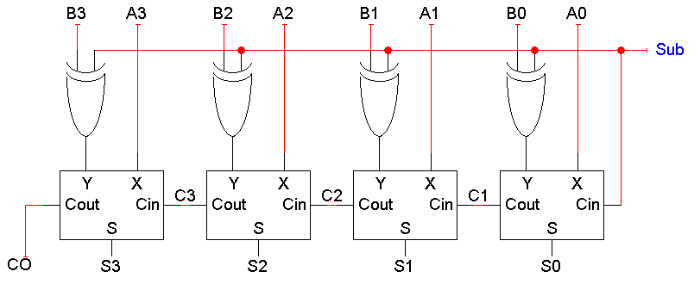
An adder subtractor circuit

Slide 25
Review Questions
Briefly explain the following representations: sign magnitude, twos complement, biased.
Explain how to determine if a number is negative in the following representations: sign magnitude, twos complement, biased.
What is the sign-extension rule for twos complement numbers?
How can you form the negation of an integer in twos complement representation?
In general terms, when does the twos complement operation on an n-bit integer pro- duce the same integer?

Slide 26
Thank you

